Slide 2
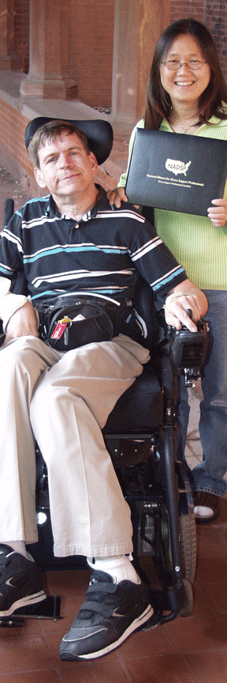
What is Community Living?
Living and being included in the community
Goes beyond physical presence
  Living with needed supports in the most inclusive setting possible with opportunities for:
    Making friends
    Engaging in daily activities in and outside of the home
    Employment and other meaningful activities (including leisure and advocacy activities)
    Exercising one’s rights (e.g., making choices and decisions)
  Feeling that you belong
  Being part of rather than just living in the community

Slide 3
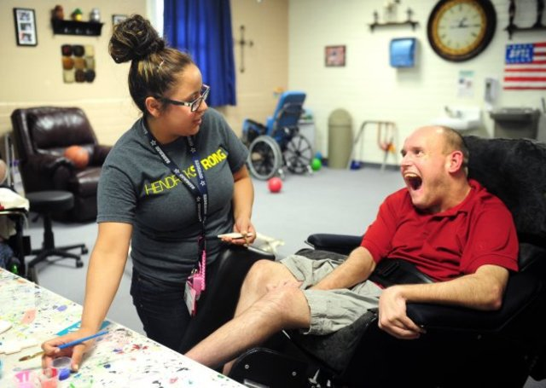
Change in Service Models
1900-1990: Medical Model
  Disability as defect
  Disability exists within the person
  Focus on minimizing/removal
Post 1990: Supports Framework
  Disability as diversity
  Disability results from person/environment interaction
  Focus on supports rather than disability related challenges

Slide 4
Current Support Framework
Capabilities
Intelligence Adaptive Skills
Environments
Home School/Work Community
Support Type & Intensity
Functioning

Slide 5
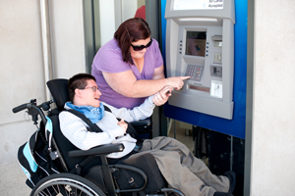
Implications of Supports Model
Supports orientation has brought together related practices of:
  Person-centered planning,
  Personal growth and development opportunities,
  Community inclusion, and
  Self-determination/ empowerment
  (Luckasson et al., 2012)

Slide 6
What Drives Community Living Supports in U.S.? HCBS Settings Final Rule
All HCBS settings must:
  Be integrated in and facilitate full access to the greater community;
  Optimize autonomy and independence in making life choices;
  Be chosen by the individual from among residential and day options, including non-disability specific settings;
  Ensure the right to privacy, dignity, respect and freedom from coercion and restraint;
  Provide an opportunity to seek competitive employment;
  Provide individuals an option to choose a private unit in a residential setting; and
  Facilitate choice of services and who provides them.
Each state must develop a plan of compliance with the Rule
  State plans must be approved by federal government &
  Include a method for evaluating outcomes people experience

Slide 7
Who Funds Services to Persons with IDD?
Medicaid program funds over 75% of all publicly funded long-term supports for individuals with intellectual and developmental disabilities (IDD) in US
Majority of spending attributed to Home and Community Based Services (HCBS) Waiver program.
First authorized by Congress in 1981 as an avenue for states to target groups of beneficiaries at risk of institutionalization,

Slide 8



U.S. Dept. of Health & Human Services
Center for Medicaid & Medicare Services and Supports (CMS)
50 States
HCBS IDD Waiver
Program
Elderly Disability Waiver
Program
PD Waiver
Program
DD Waiver
Program
PD Waiver
Program
Personal Employment
Social Security
Disability Income

Slide 9
Medicaid Funding
Joint federal-state program
Federal government matches percentage of state spending
Medicaid funds:
  Heath care
  Therapy
  Employment ($903 million for Employment and Day Programs)
  Home and community based services

Slide 10
HCBS Funding
States use flexible Medicaid HCBS Waiver program to fund expansion of community services received federal matching dollars;
HCBS Waiver has become the primary funding source for promoting long-term services and supports for people with IDD.
In FY 2015, federal–state spending for the HCBS Waiver program reached over $45.1 billion and constituted almost half of total funding across the nation that year (Braddock et al., 2011).

Slide 11
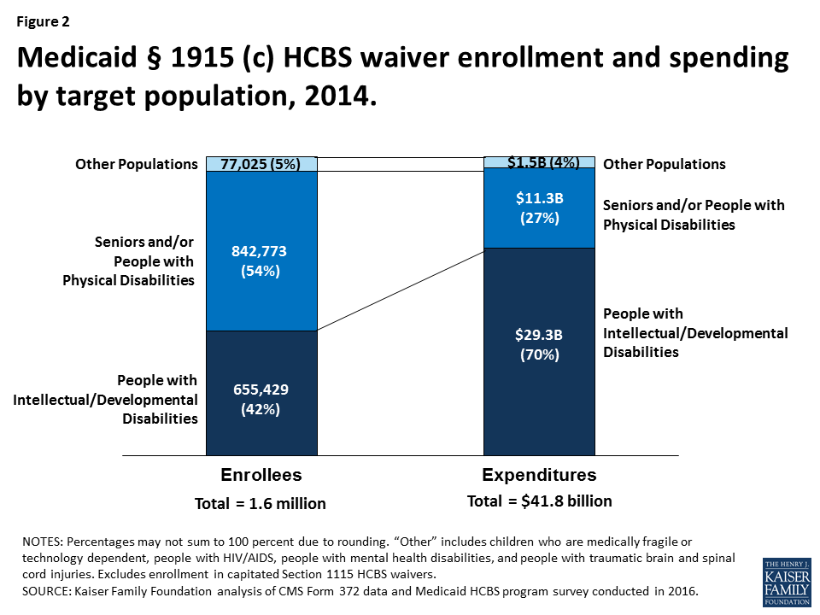
HCBS Recipients & Costs

Slide 12

U.S. Living Arrangement Options
Wide variety of community Living options for adults with IDD in the U.S.
  Living with Family
  Community living Residence (Group Home)
  Alternate Family Living/Foster Care
  Semi-Independent Living
  Independent Living (Rental)
  Independent Living (Home Ownership)
  Self-directed supports

Slide 13

Self-Directed Support Programs
Support funding for person with disabilities has typically gone directly to provider organization
  Provider controls how support funding is spent
  Person with disability has no responsibility for managing funding, but also no control over it
  Can result in a provider not using funding in manner that supports person with disability to live the life they want to lead.
Notes:
1990s
Emergence of prevention science that focuses on issues beyond physical health (mental health issues)

Slide 14

Self-Directed Support Programs
Self-Directed Supports: Relatively new program intended to provide persons with disabilities with:
  Flexibility in how their support funding is spent
  Greater self-determination and control over these funds
  Ability to use funding to receive supports that help them achieve their personal goals

Slide 15
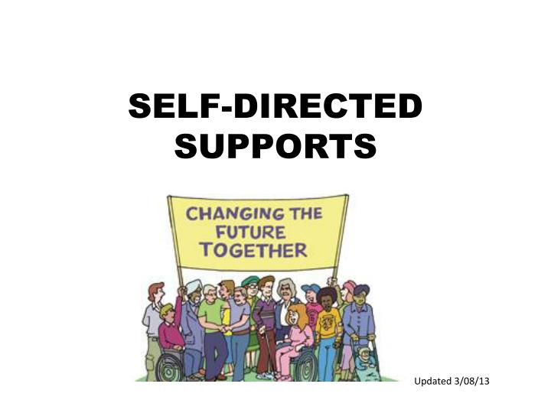
Self-Directed Support Programs
Financial: Family or NGO serves as “fiscal intermediary” for person with disability making sure services/supports are paid
Managing Supports: Person with disability, with help if needed, manages their own services and supports deciding:
  What supports they need
  Who to hire to provide these supports
  If supports are meeting their needs (can fire a support organization)
  When to change supports or support providers
Choice & Control: Theoretically provides persons with a disability with almost total control over their supports
Notes:
1990s
Emergence of prevention science that focuses on issues beyond physical health (mental health issues)

Slide 16
National Quality Forum Updates
Choice and Control
Consumer Leadership in System Development
Human and Legal Rights
System Performance & Accountability
Community Inclusion
NQF FRAMEWORK FOR HOME & COMMUNITY BASED SERVICES
OUTCOME MEASUREMENT
11 Domains
2-7 Subdomains
Equity
Holistic Health and Functioning
Service Delivery & Effectiveness
Workforce
Person-Centered Service Planning and Coordination
Caregiver Support

Slide 17
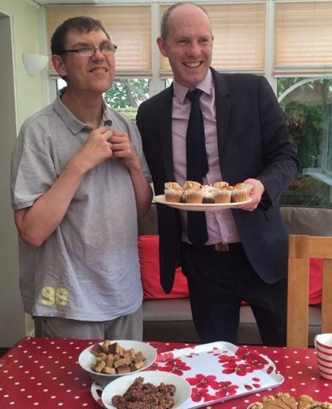
Outcomes of Community Living
Overall people with disabilities of all levels of severity living in the community in homes that serve small numbers of individuals are more included into the community facilitating greater access to:
  friends
  family
  employment in typical businesses, and
  participation in local affairs and activities
  self-determination (including making choices and decisions)
Moseley, Walker, Cichocki, Ticha, Taylor, & Sowers (2015)
Notes:
1990s
Emergence of prevention science that focuses on issues beyond physical health (mental health issues)

Slide 18
University of Minnesota
Institute on Community Integration –ICI
Global Resource Center on Inclusive Education
Brian Abery, Ph.D.
E-mail: abery001@umn.edu
Renáta Tichá, Ph.D.
E-mail: tich0018@umn.edu

